Slide 1
Chapter 9 – Objects and Classes
Reading Assignment: Chapter 9 in Introduction to Programming with C++, 3rd Edition, by Liang.
So far we have focused on procedural programming which can be accomplished in C or C++.
C++ is an improvement over C in that it allows users to define classes.
Objects are defined within classes.
Programming that uses classes and objects is referred to as object-oriented programming (OOP).
Object-oriented programming enables you to develop large-scale software effectively.
We have used classes with strings (class string) and with data files (class fstream).
In this chapter we will learn to create our own classes.
1
1
Notes:
1

Slide 2
Definitions:
Class – a combination of data (data members or data fields) and functions (member functions) that manipulate the data.
Classes might be used to represent almost any category that you might imagine, including complex numbers, geometric shapes, jobs, automobiles, weather, etc.
A class is like a template or blueprint that defines what the data members and member functions will be for each object.
No memory is allocated by simply defining a class.
Object – An object is officially defined as a “a region of storage”, but this simply means that an object can be defined to store various quantities or types of data within a class.
An object within class automobiles might include data members such as year, engine size, body style, etc., and might use member functions to estimate mpg and cost.
An object is an instance of a class.
Creating an object within a class is called instantiation.
Memory is allocated when an object is created (or instantiated).
2
2
Notes:
2

Slide 3
Why use Classes?
Classes form a group of functions that are designed to work with a particular grouping of data (object). This creates distinct boundaries in C++ in that specialized functions and objects are used that aren’t defined as part of the main C++ language.
It is easier to coordinate the work of multiple programmers as they can test and debug their own program segments and other users can interface with multiple program segments without knowing the details of how it was written (such as the way that we used the string class and string functions without ever seeing the code).
By compiling thoroughly tested and debugged program segments, more reliable larger programs can be created.
Classes created by independent vendors can be readily incorporated into your work which will reduce programming time. For example, if you need to work with complex numbers, you might look for complex number classes that are already available. In EGR 120 we make use of a class for servos. In EGR 262 we make use of classes for motor controllers and IR sensor arrays.
3
3
Notes:
3

Slide 4
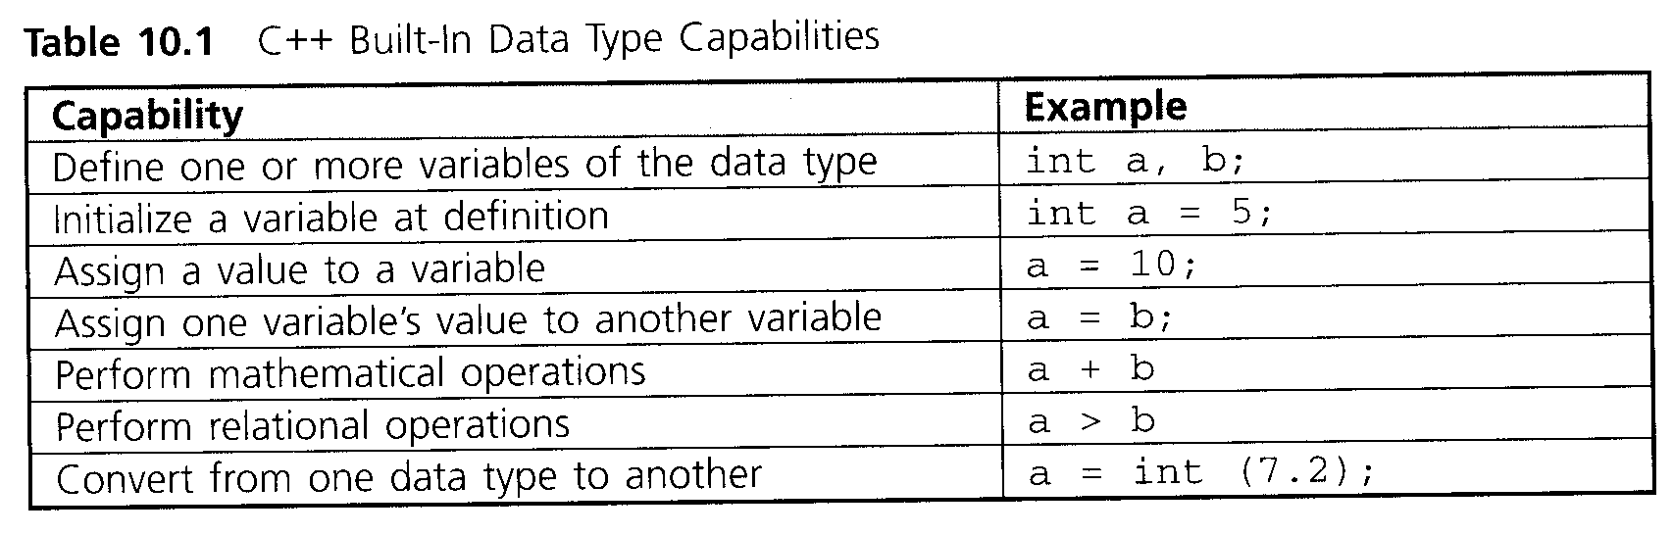
Abstract Data Types (ADTs)
C++ includes a number of built-in data types, including int, double, float, char, and bool.
Associated with each data type is a set of operations that are used to initialize and manipulate the type.
Data Type = Allowable data values + Operational capabilities
The table below shows built-in data type capabilities for int, double, bool, and char types
(Ref: C++ for Engineers & Scientists, 3rd Edition, by Bronson).
4
4
Notes:
4

Slide 5
Abstract Data Types (ADTs) - continued
An abstract data type (ADT) is a user-defined type that defines both a type of data and the operations that can be performed on it.
There is an endless list of examples of abstract data types. Here are a few:
Dates
Complex numbers
Points (x,y,z)
Student information
Cars
Geometric shapes
Etc
In C++, an abstract data type is referred to as a class.
5
5
Notes:
5

Slide 6
Structs and Classes
A struct is an older type of structure in the C language that represents a grouping of data, but not functions.
Structs are still supported by C++, but have been largely replaced by the more powerful class. A class represents a grouping of both data and functions.
Some texts begin by defining structs and then move into classes.
We will bypass structs and begin with classes directly.
6
6
Notes:
6

Slide 7
Defining a class
A class is defined using the following form. Note that keywords are
in blue.
Form:
class Class_Name //use any valid identifier for class name
{
private: //only available to member functions
private_members; // declare various data/functions
public: //available outside of class (such as in main)
public_members;
};
7
7
Notes:
7

Slide 8
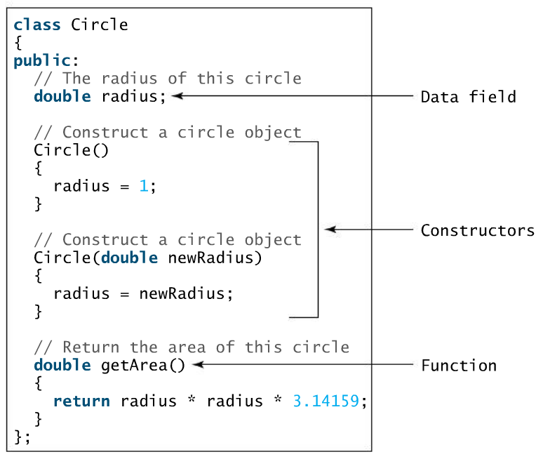
Class Circle – Text example
A text example defines a class named Circle.
8
Constructors are special member functions used to initialize objects. More on this later.
Notes:
8

Slide 9
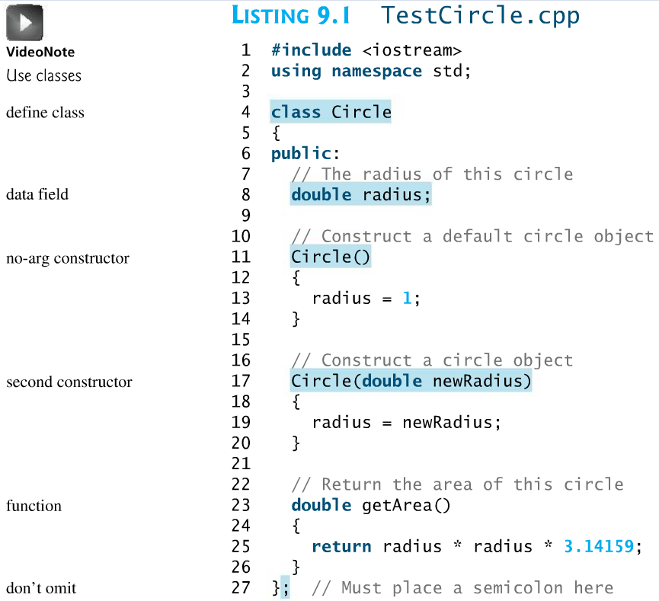
TestCircle.cpp includes the definition of class Circle and a main program that uses the class to define and initialize three objects (circles) and uses public member function getArea( ) to find the area of each circle.
9
(continued)
Notes:
9

Slide 10
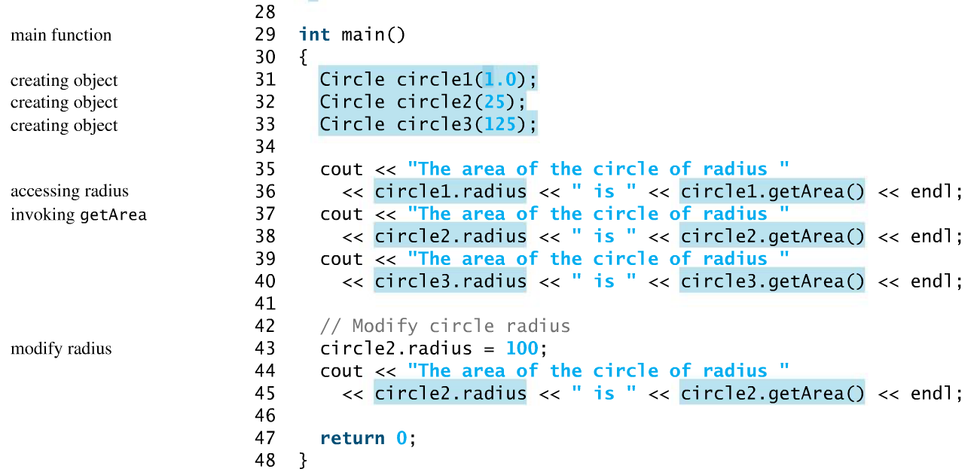
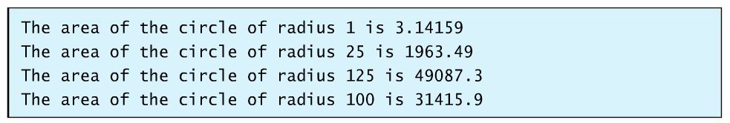
TestCircle.cpp (continued)
10
Program Output:
Notes:
10

Slide 11
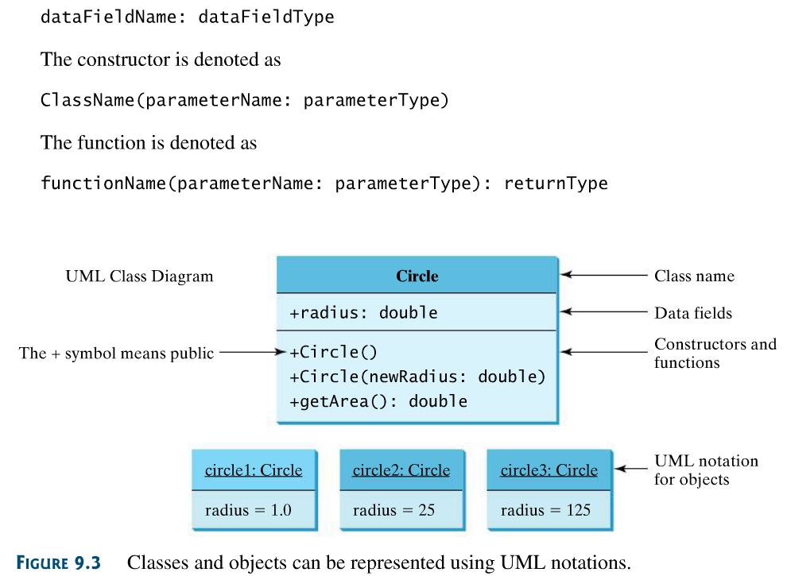
Class Diagrams
The structure of class and objects is sometimes illustrated using UML (Unified Modeling Language) class diagrams (or simply class diagrams). Class Circle and the three objects created in the previous example are illustrated below.
11
11
Notes:
11

Slide 12
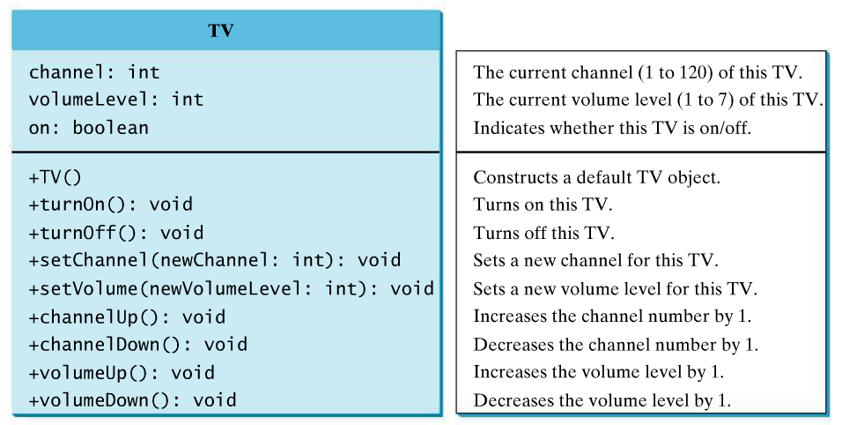
Designing a class
Class diagrams can be useful when designing a class. It can help illustrate:
Data members (data fields) – Used to define the state, properties, or attributes of an object.
Member functions – Used to control the behavior or actions of an object.
The text defines class TV. If you were to define key properties of a TV and key functions of a TV, what would you include in the class? Consider the class diagram below. The code for the class is provided in the textbook.
12
Data
members
Member
functions
Notes:
12

Slide 13
Describing classes
Let’s discuss classes and class members in general terms.
Some texts use the following descriptions:
Classes are general categories that are described by nouns.
Data members represent properties or features within a class and are generally described by nouns.
Function members are used to perform operations involving data members and are generally described by verbs.
A class (along with its data members and function members) is like a mold. It only defines something, but does nothing.
An object (an instance of the class) is like something made from the mold. It now has the properties of the mold, takes up space (memory), and can be used.
13
Notes:
13
13

Slide 14
Examples of Classes
Fill out the class diagrams below describing potential classes, data member, and member functions.
Class Name: Triangle (noun)
Data Members: Side1: double Side2: double Side3: double (all nouns)
Member Functions: +TestIfValid( ); +FindAngles( ); +FindArea(); +FindPerimeter( ); (all verbs)
Class Name: Line
Data Members:
Member Functions:
Class Name: Pay Stub
Data Members:
Member Functions:
14
Notes:
14
14

Slide 15
Examples of Classes
Fill out the class diagrams below describing potential classes, data member, and member functions.
Class Name: string
Data Members:
Member Functions: +find( ) +insert( ) +erase( ) +length( ) +substr( )
Class Name: ComplexNumber
Data Members:
Member Functions:
Class Name: IBeam
Data Members:
Member Functions:
15
Notes:
15
15

Slide 16
Example
Suppose that we define a class of parabolas.
Class Parabola shown on the next slide will illustrate:
The use of public members and private members
The use of member functions
Recall that a parabola is define by the equation:
Class diagram:
Class Name: Parabola
Data Members: a: double b: double c: double
Member Functions: +read_coeff( ) +calc_area( )
Therefore, the coefficients a, b, and c define the parabola
and it is reasonable to make a, b, and c data members in
class Parabola.
We could add various functions to work with parabolas, but this simple example will just include two member functions:
A function to read the parabola coefficients
A function to find the area under a parabola, which is found as follows:
16
16
Notes:
16

Slide 17
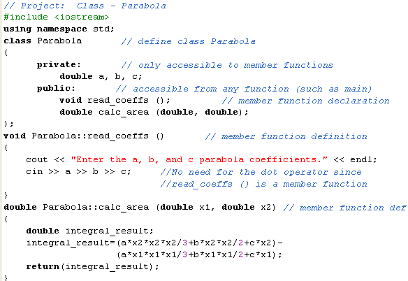
Example: class Parabola
Ref: Programming in C++, by D’Orazzio – Chapter 8).
17
Note that since the member functions are defined outside of the class:
the class includes function declarations (prototypes)
the class name (Parabola) and the scope resolution operator (::) must precede the function name (calc_area).
Notes:
17

Slide 18
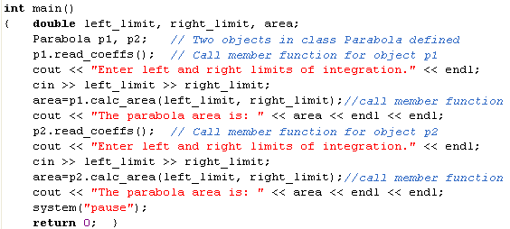
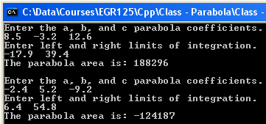
Example: class Parabola (continued)
18
18
Notes:
18

Slide 19
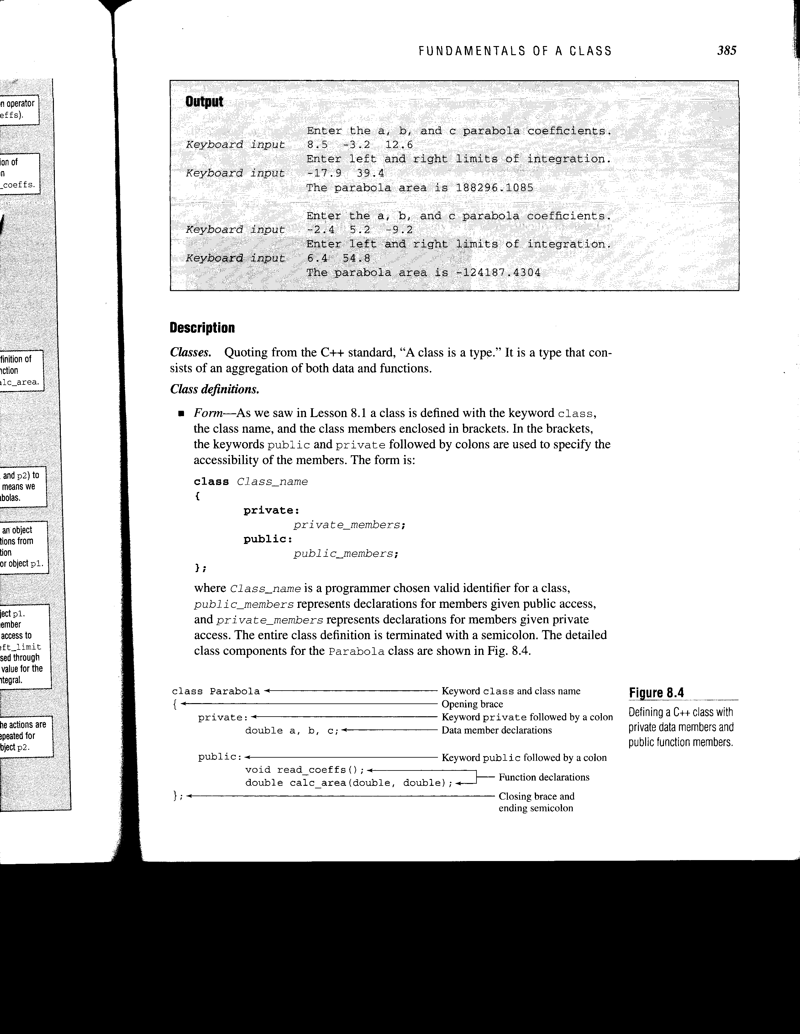
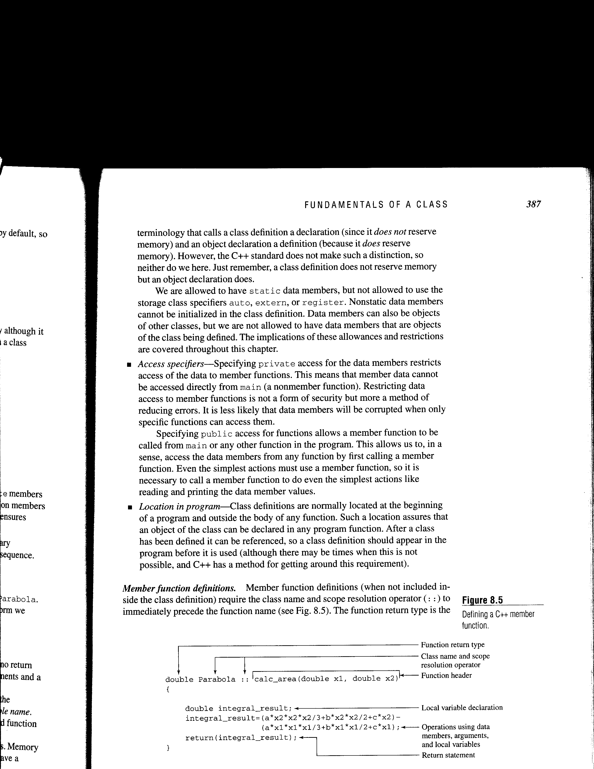
Class Parabola – Class and Member function definitions
Notes:
19

Slide 20
Public members
Public data members and function members are available to other functions in the program, including main.
Dot notation is needed by non-member functions to access data members or function members.
In the last example, main (a non-member function) included p1.read_coefficients (): // dot notation needed
Dot notation is not needed by member functions to access data members or function members
In the last example, read_coeffs () (a member function) included cin >> a >> b >> c; // dot notation NOT needed
// (i.e., use cin >> a; not cin >> p1.a; )
Private members
Private data members and function members are NOT available to other functions in the program, including main.
For example, you cannot read private data members from main:
cin >> p1.a >> p1.b >> p1.c; // not allowed since a,b,c private
Notes:
20

Slide 21
Encapsulation
Encapsulation is the cornerstone of object-oriented programming (OOP).
Encapsulation describes the link between data and functions for an object.
The result of encapsulation is that data access is restricted to member functions which is sometimes called data hiding.
The goal of data hiding is not secrecy or security, but the reduction of errors. It is less likely that data members will be corrupted when only specific functions have access to them.
Encapsulation allows us to create programming units that have specific boundaries which leads to more reliable software.
The concept of encapsulation for class Parabola is illustrated in the following slide.
21
21
Notes:
21

Slide 22
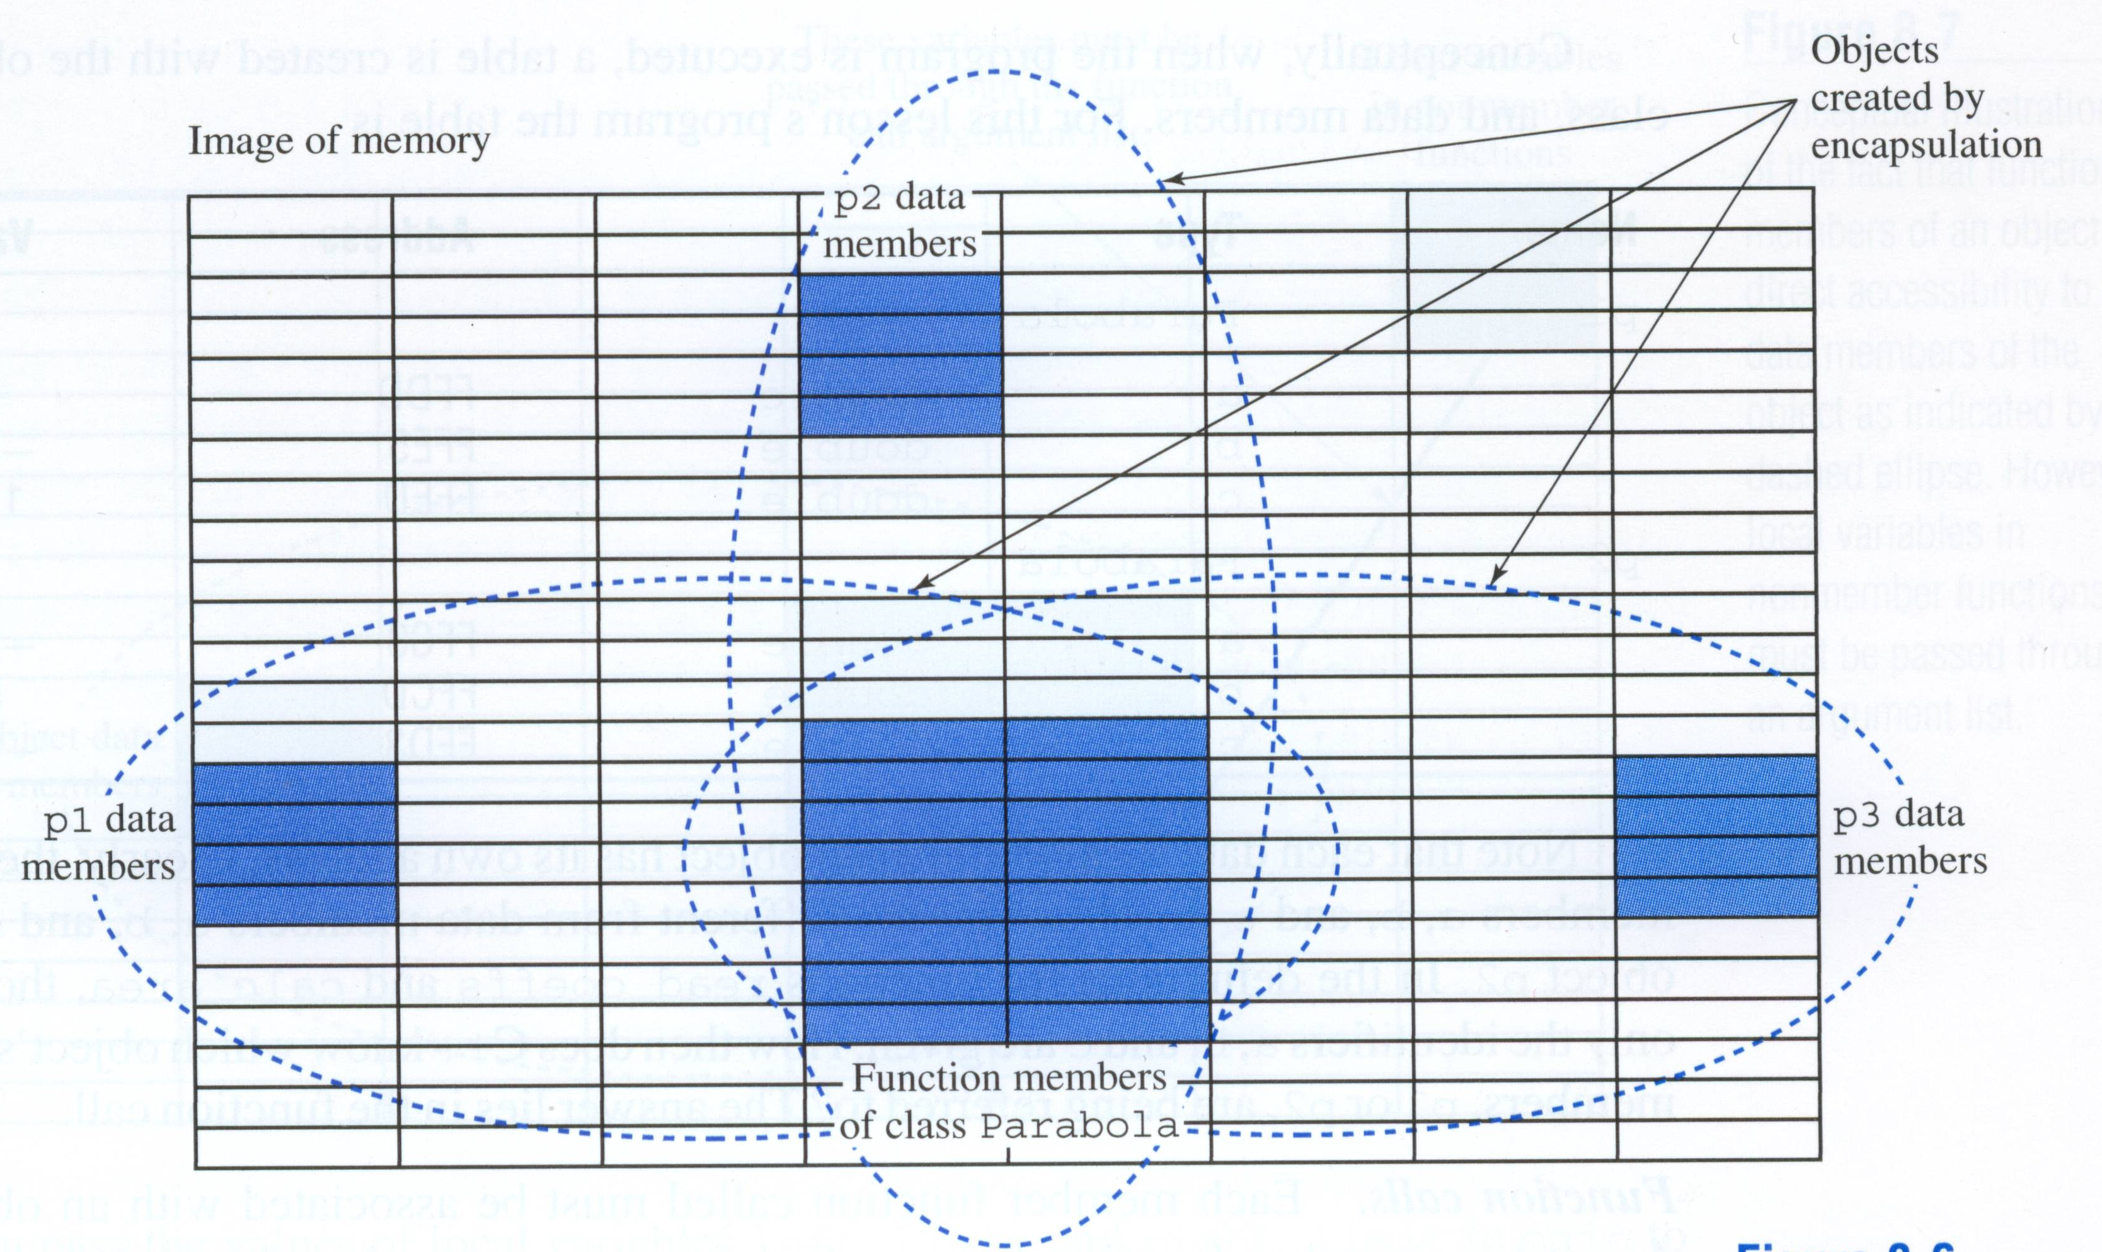
Encapsulation – illustration for class Parabola
Three objects, p1, p2, and p3 are illustrated above. The memory for the data members (a,b,c) for each object is separate and unique, but the memory for the member functions is shared. The data members and member functions are linked in an object.
Notes:
22

Slide 23
Class Programming Example
Try the following example during class (as much as possible):
Class Name: Triangle
Data Members: Side1, Side2, Side3 Angle1,Angle2,Angle3
Member Functions: +Read_Sides( ); +Print_Sides( ); +Test_If_Valid( ); +Find_Angles( ); +Print_Angles( ); +Find_Area(); +Find_Perimeter( );
More features will be added to this class during our next meeting (so be sure to save the project).
23
Notes:
23
23

Slide 24
Constructor Functions (Constructors)
Constructors are commonly used to initialize data members
when objects are declared.
Constructor characteristics:
Constructors are member functions that are automatically executed upon declaration of an object.
The constructor name is identical to the class name.
The constructor has no return value (cannot use void either).
The constructor has public access (so objects can be declared in any function).
The constructor may or may not have arguments.
You often can’t tell is a constructor is present unless you look at the list of member functions (typically listed first).
24
Notes:
24
24

Slide 25
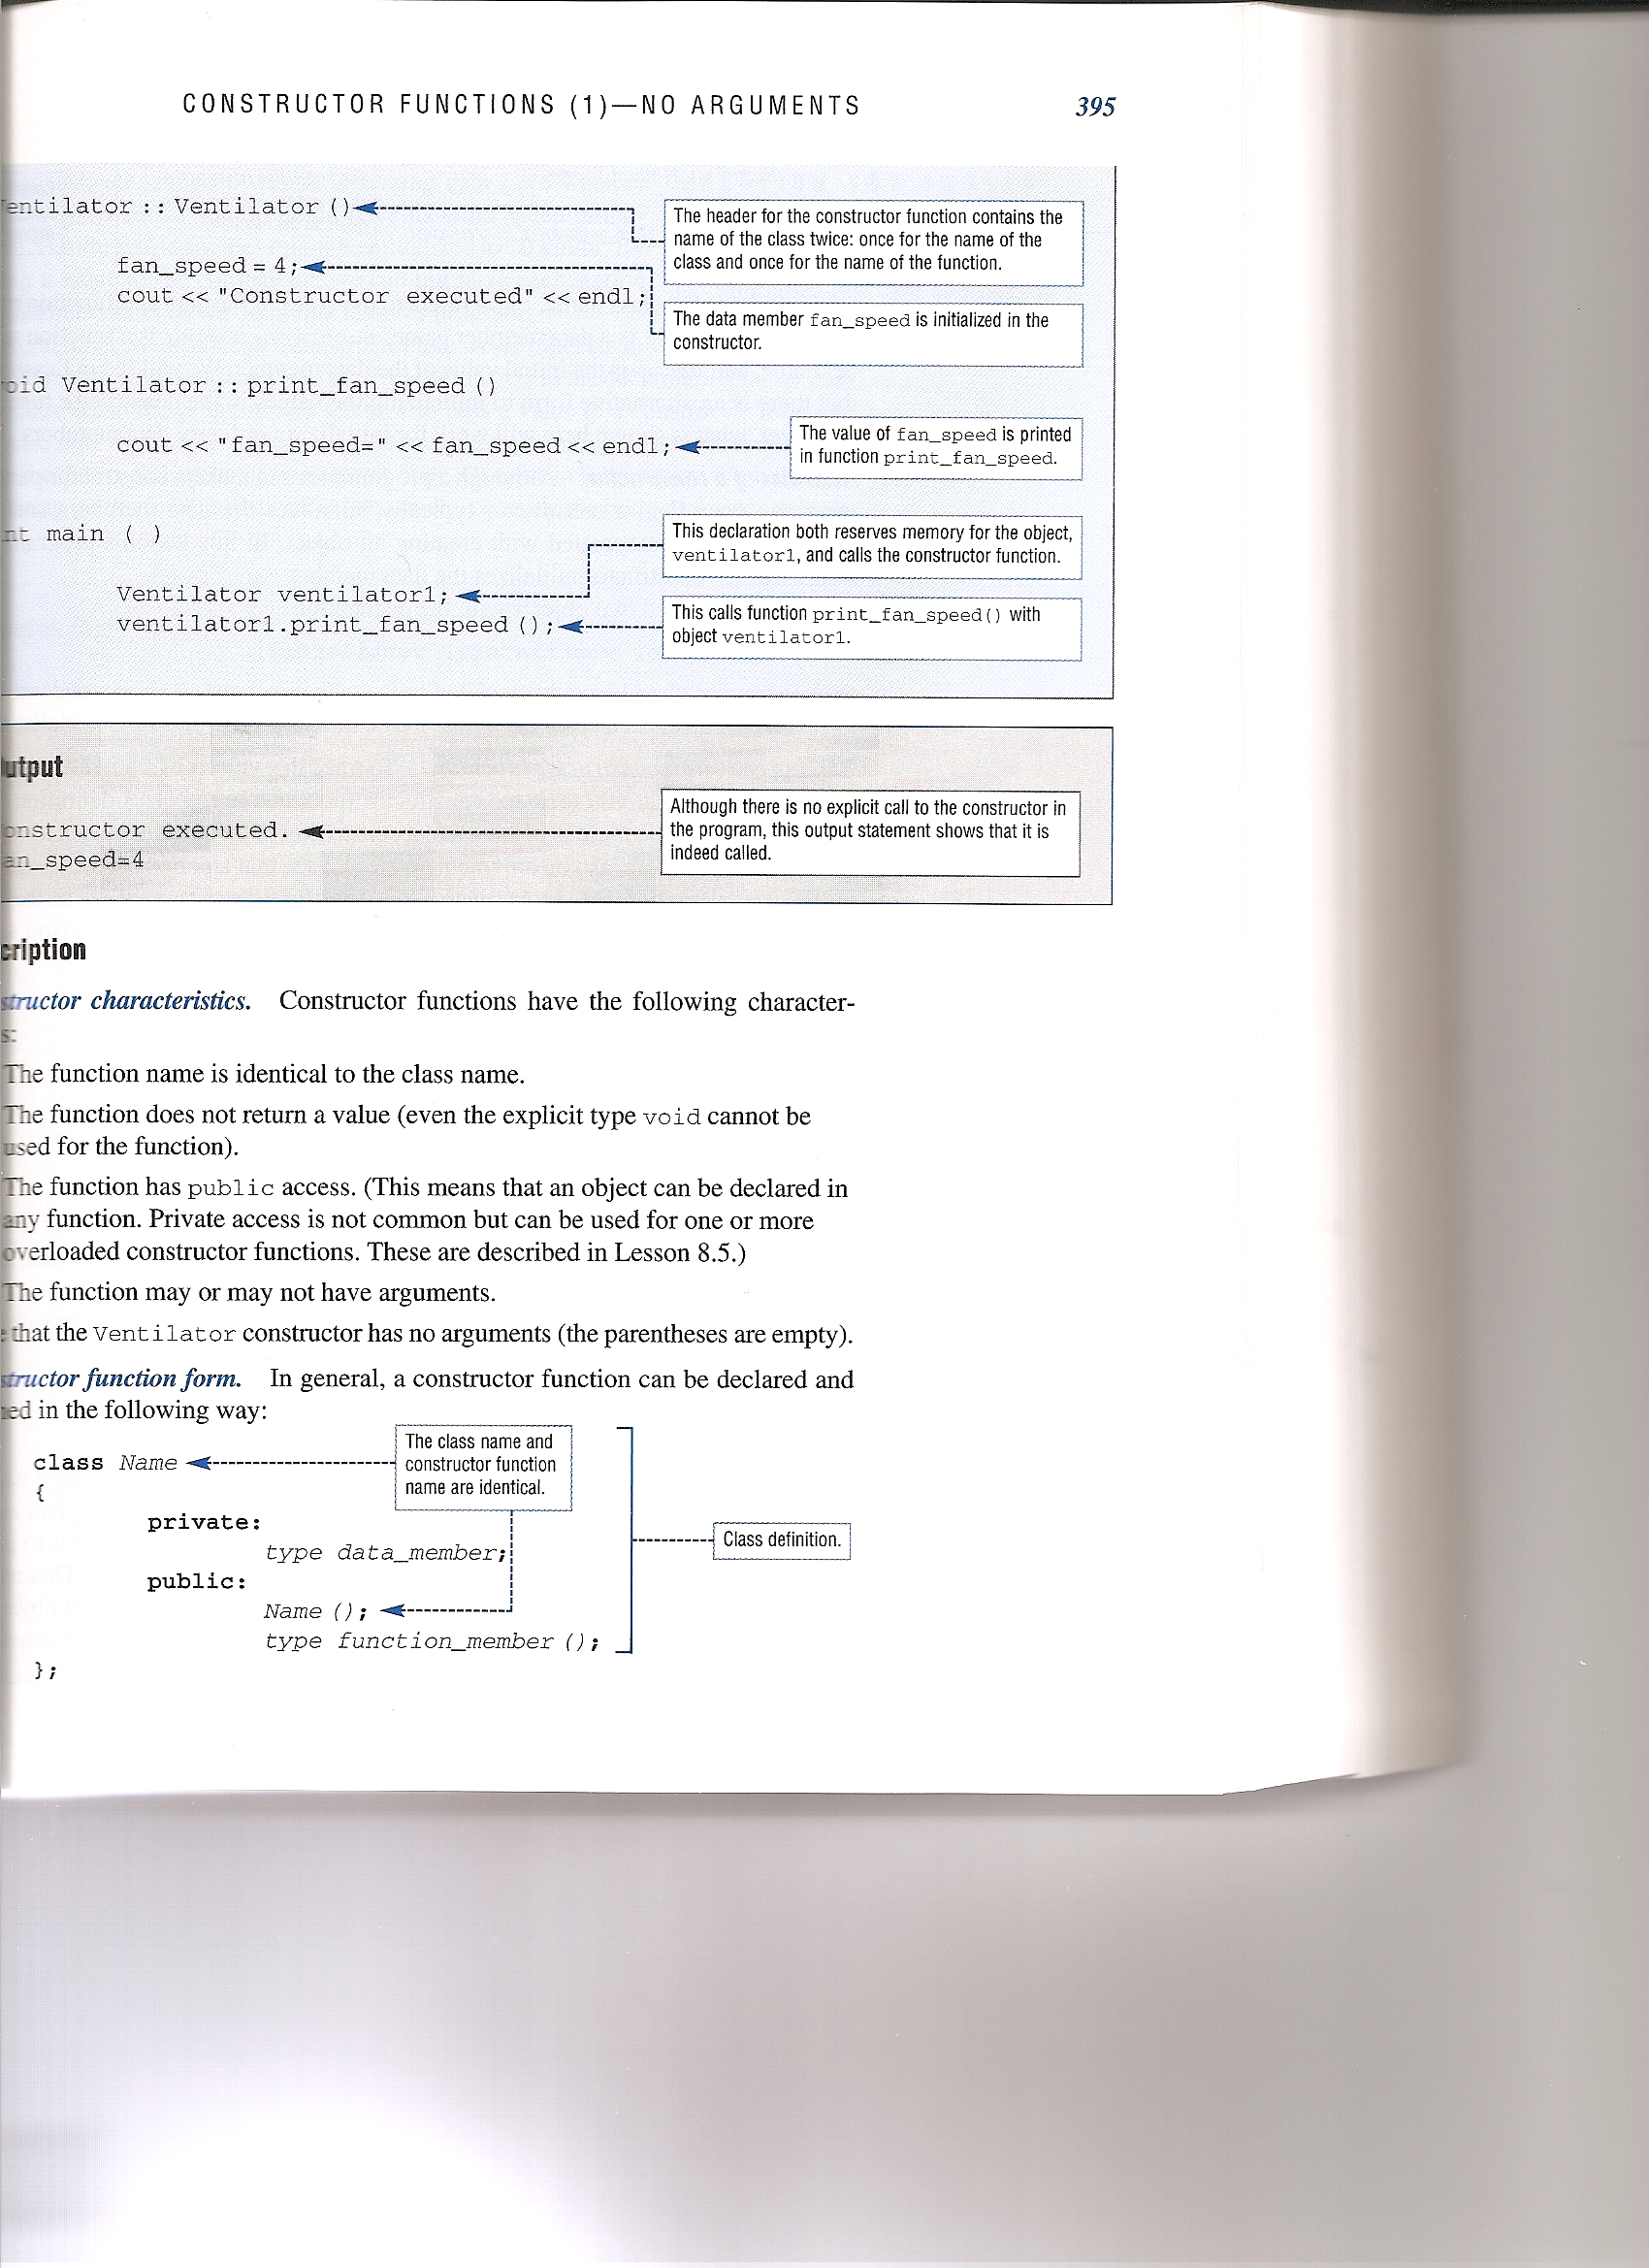
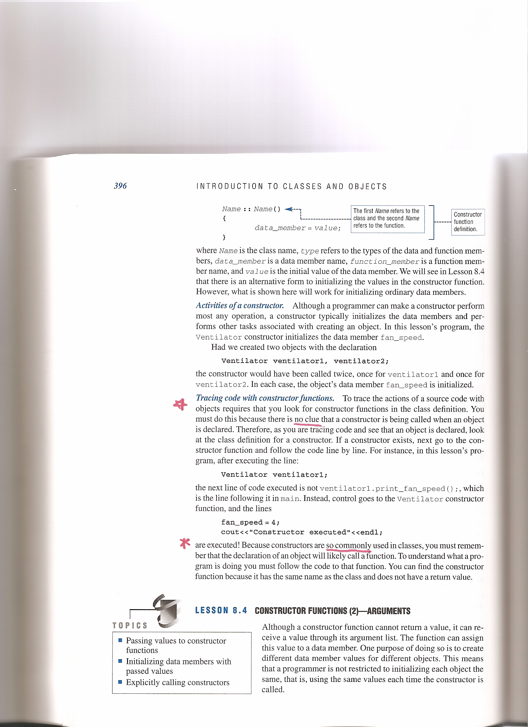
Constructors - format
Ref: Programming in C++, by D’Orazzio – Chapter 8).
25
Notes:
25
25

Slide 26
Initializing variables in C++ programs
In C++ programs we often initialize values, such as summations, max or min values, constants, etc.
Example:
double Grade, MaxGrade = 100, MinGrade = 0;
double Average, Sum = 0.0, TaxRate = 0.05;
Initializing objects with constructors
Similarly, we might want to initialize data members in objects. Data members cannot be initialized in the class definition. For example, we cannot do the following:
class Parabola
{
private:
double a = 0, b = 0, c = 0; // NOT allowed!
}
So instead we initialize data members with a constructor.
26
Notes:
26
26

Slide 27
Example: Using a constructor to initialize data members when objects are declared.
class SavingsAccount
{ private:
double Initial_Balance, Current_Balance, Interest_Rate;
public:
SavingsAccount(); // constructor (same name as class)
void MakeDeposit(); // member function
void MakeWithDrawal(); // member function
};
SavingsAccount::SavingsAccount() // constructor definition
{ Initial_Balance = 0.0;
Interest_Rate = 0.05;
}
int main()
{ SavingsAccount S1,S2; // declare two objects and execute
// the constructor for each object, setting the initial balance
// to 0 and the interest rate to 0.05 for each object.
27
Notes:
27
27

Slide 28
Using classes as arguments or return types of functions.
We can use classes as arguments or return types of functions just as we might use any type.
Examples prototypes: (recall that string is a class)
int Function1(int, double);
int Function2(int, double, string);
string Function3(string);
void Function4(int, double, Class1);
Class1 Function5(Class1, Class2);
28
Notes:
28
28

Slide 29
Header and Implementation Files
Recall that when we used class string and class fstream, we didn’t need to see the class definition, member function definitions, etc. We simply wanted to use the classes and attached the classes to our project with:
#include <string>
#include <fstream>
Similarly, when we write classes, we can create the following files:
1) header file
Contains the class definition
Is generally named after the class with a .h extension
For class Circle, the header file would be Circle.h
Add the following to main.cpp:
#include “Circle.h”
2) implementation file
Contains the member function definitions
Is generally named after the class with a .cpp extension
For class Circle, the header file would be Circle.cpp
Also add the same include statement used above:
#include “Circle.h”
Note that this is similar to creating a library of functions – See Chapter 6 lecture notes
29
Notes:
29
29

Slide 30
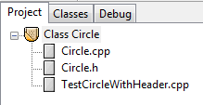
Header and Implementation Files
The previous example using class Circle is repeated below using header and implementation files. Note that each of these files is attached to the project so that compiler knows to compile each of them.
Right click on the project name and select “New File” to create each file listed
Implementation File
Header File
main File
30
Notes:
30
30

Slide 31
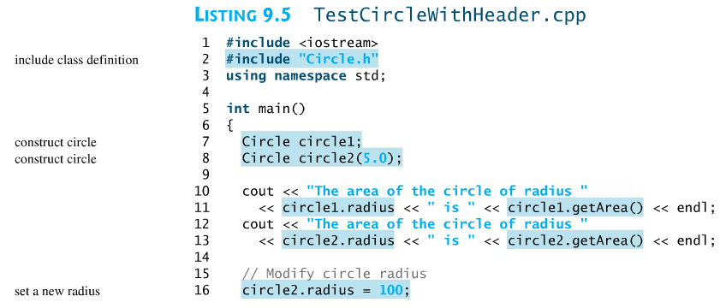
TestCircleWithHeader.cpp (main function)
The header file and implementation file for class Circle are shown on the following two pages.
31
Notes:
31
31

Slide 32
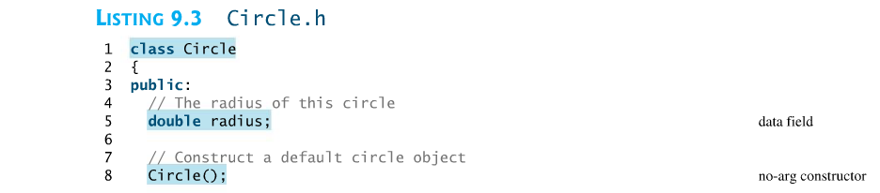
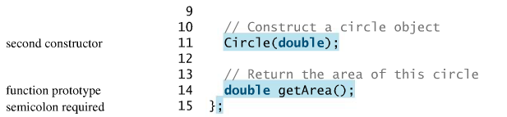
Circle.h
Note that a prototype was included for each member function.
32
Notes:
32
32

Slide 33
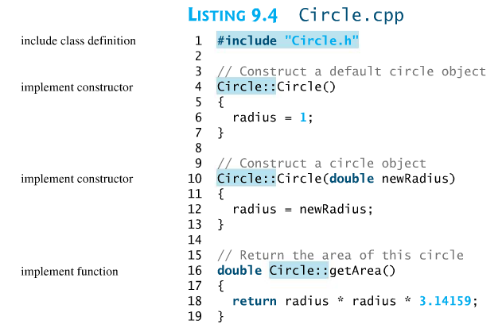
Circle.cpp
Note that Circle:: had to be included before each function since the functions are in a separate file
33
Notes:
33
33

Slide 34
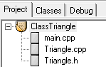
Class Programming Example
Download class Triangle created last class from the course Bb site.
Modify class Triangle to add the following features:
Create implementation and header files and add them to the project (Triangle.cpp and Triangle.h as shown below)
Write additional member functions as shown on slide 23 if they weren’t completed last class.
Add a constructor so that triangles can be initialized in a manner similar to the ones shown below:
Triangle T1(3,4,5), T2(6,8,10), T3(5,12,13)
Note: Another option is to use a second default constructor could be used to create a 3,4,5 triangle if no arguments are specified.
34
Notes:
34
34

Slide 35

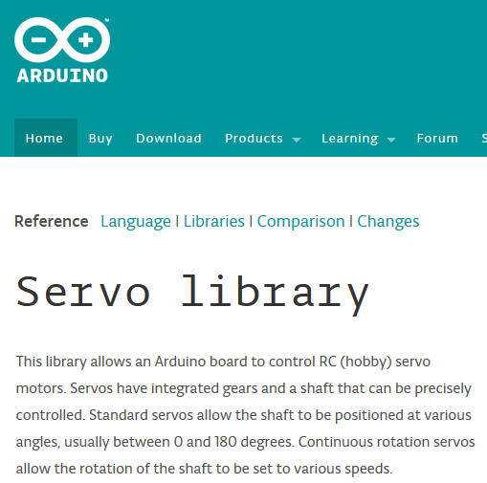
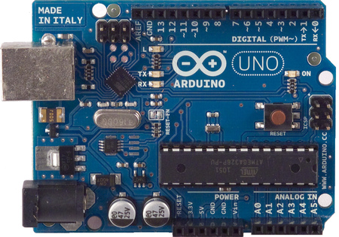
Practical example of using classes
It is common to use products that include software with classes. Consider two examples:
Class Servo – In EGR 120 and EGR 262, we use servos (small motor/gearbox combinations with electronic control) along with the Arduino UNO microcontroller. The Arduino UNO includes a class for controlling the servo.
35
Notes:
35
35

Slide 36
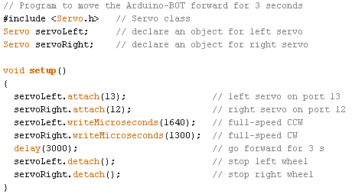
Consider the example below from EGR 120:
Classes are also downloaded and used in EGR 262 for:
Qik Motor Controller
QTR-8RC Digital Sensor Array
36
Notes:
36
36

Slide 37
Classes with arrays as data members
Specifying array sizes for private data members
Specifying arrays as private data members of classes is similar to specifying other variables, except that arrays must be sized in a particular manner.
Instructions typically used to size arrays are not allowed:
const int MaxArraySize = 20; //NOT Allowed in class definitions!
Most newer compilers will allow arrays to be sized in class definitions using static constants (which are defined once rather than each time an object of the class is declared) as follows:
static const int MaxArraySize = 20; //Allowed in class definitions
37
Notes:
37
37

Slide 38
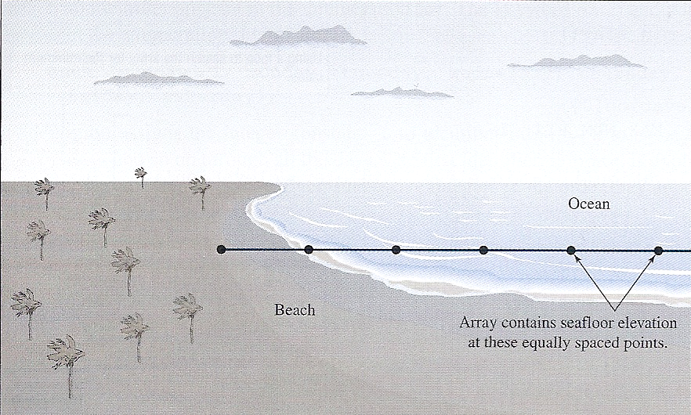
Example: Class with an array as a data member
The example below creates class Seabed to work with seafloor elevation data that is read from a file into a data member array.
Reference: Programming in C++ by D’Orazzio
38
Notes:
38
38

Slide 39
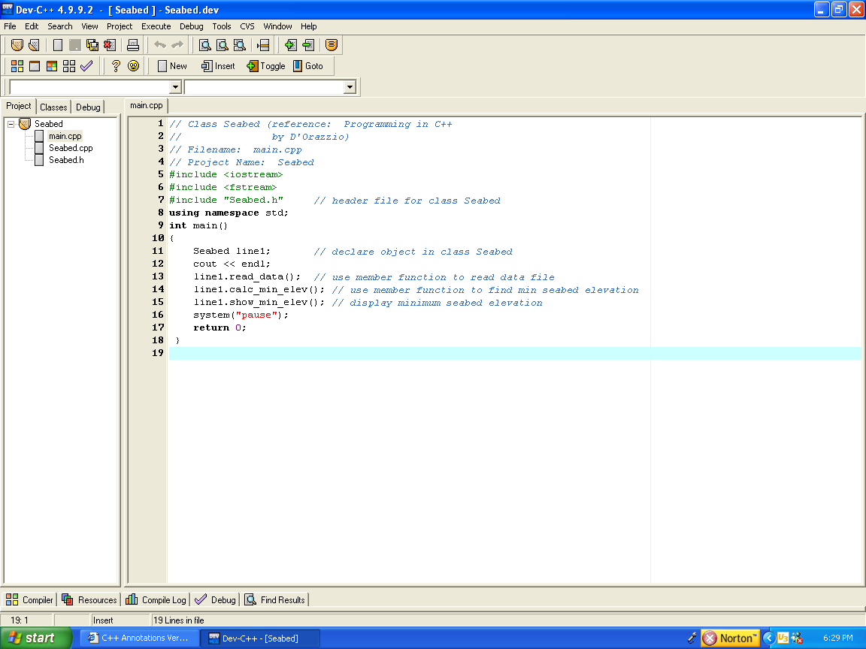
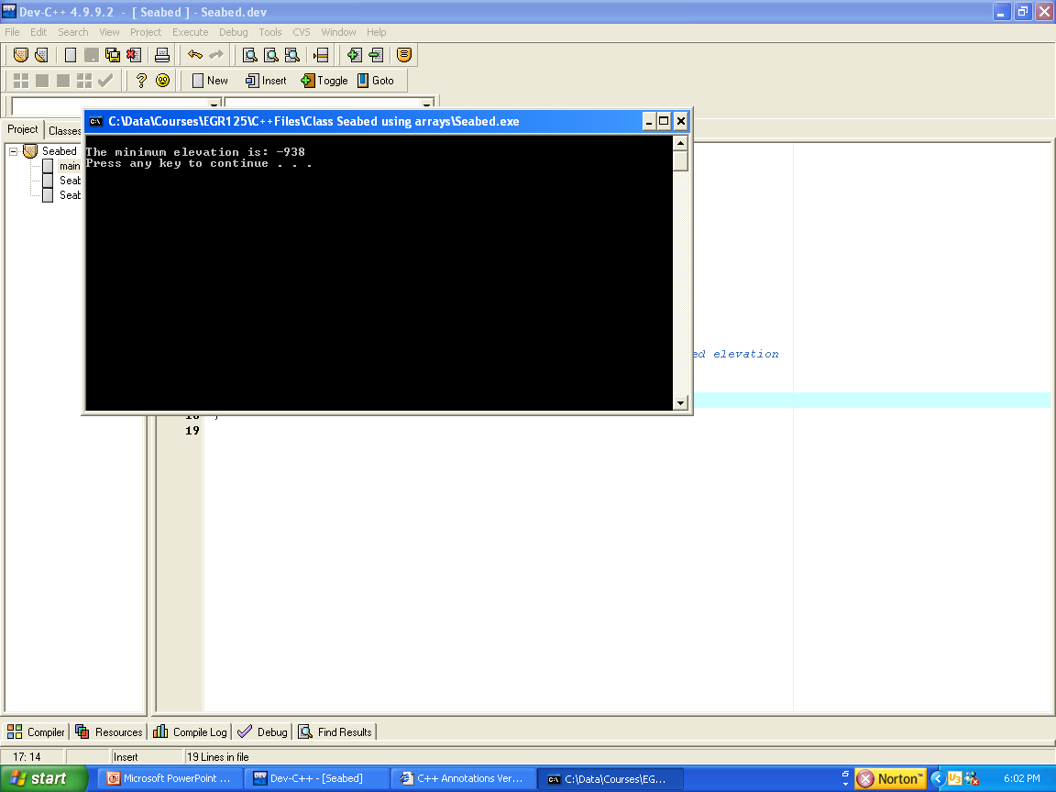
Example: Class with an array as a data member (continued)
Shown below: main.cpp
Program output:
39
Notes:
39
39

Slide 40
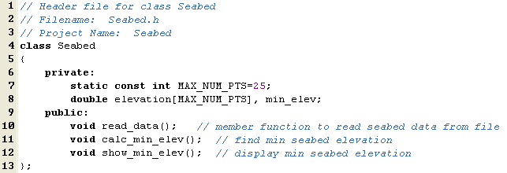
Example: Class with an array as a data member (continued)
Shown below: Seabed.h (header file)
Class diagram:
Class Name: Seabed
Data Members: MAX_NUM_PTS: static const int elevation: double[ ] min_elevation: double
Member Functions: +read_data( ) +calc_min_elev( ) +show_min_elev( )
40
Notes:
40
40

Slide 41
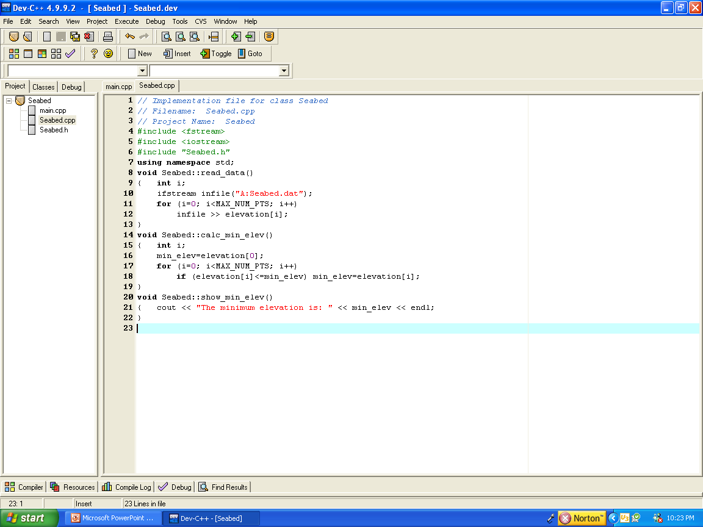
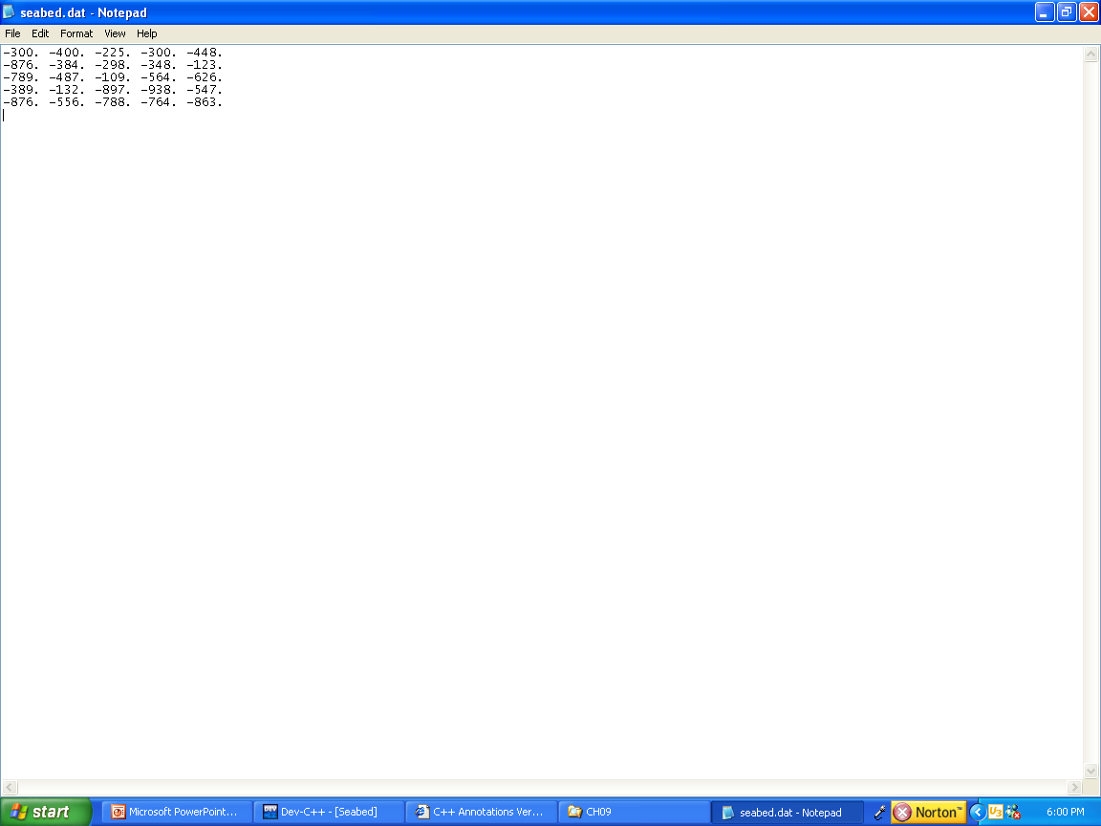
Example: Class with an array as a data member (continued)
Shown below: Seabed.cpp (implementation file)
41
Notes:
41
41

Slide 42
Arrays of objects
Reference: Section 9.6 in Programming in C++ by D’Orazzio
We can create arrays of objects similar to the way we create arrays of type int or double.
Recall that we have used arrays objects using class string.
Note that in an array of objects, each object has a unique set of data members. Example:
class CubicEquation
{
private:
double a,b,c,d; // represents ax^3 + bx^2 +cx +d
public:
(add member functions)
}
int main()
{ CubicEquation MyEqs[10]; //declare 10 objects (cubic equations)
//or 40 data members
42
Notes:
42
42

Slide 43
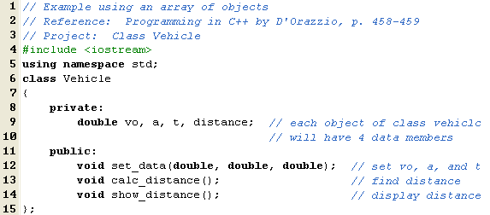
Array of objects using class Vehicle
The following example creates class Vehicle and calculates the distance a vehicle would travel given the initial velocity, acceleration, and travel time.
An array of three objects, truck[3], is created in the main function representing three vehicles.
Class diagram:
43
Class Name: Vehicle
Data Members: vo: double a: double t: double
Member Functions: +set_data( ) +calc_distance( ) +show_distance( )
Notes:
43
43

Slide 44
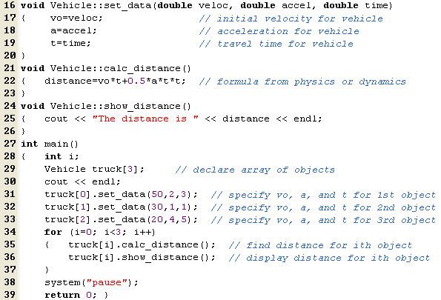
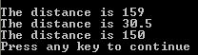
44
Reference: Section 9.6 in Programming in C++ by D’Orazzio
Program
output:
Notes:
44
44

Slide 45
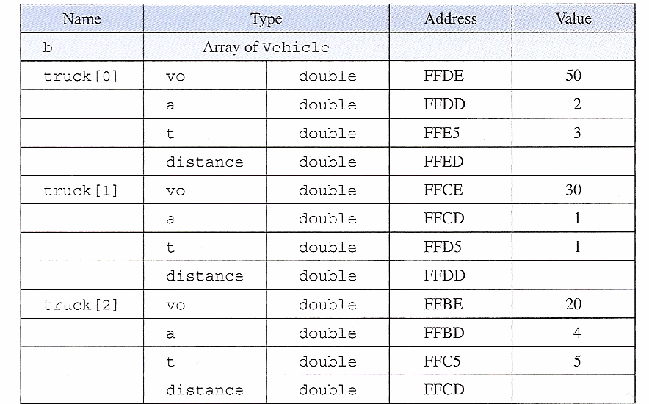
Array of Objects using class Vehicle – Illustration
The last example used an array of three objects of class Vehicle. Each object has its own set of data members as illustrated below.
Note that (3 objects)(4 data members/object) = 12 total data members.
We aren’t concerned with the addresses here.
45
Notes:
45
45

